Slide 1
CHARACTERIZING END OF LIFE CARE UTILIZATION & COSTS ACROSS THE UNITED STATES
Akane Shu, Elizabeth Anderson, Pari Kompala, Natt Chan
March 7, 2022

Slide 2
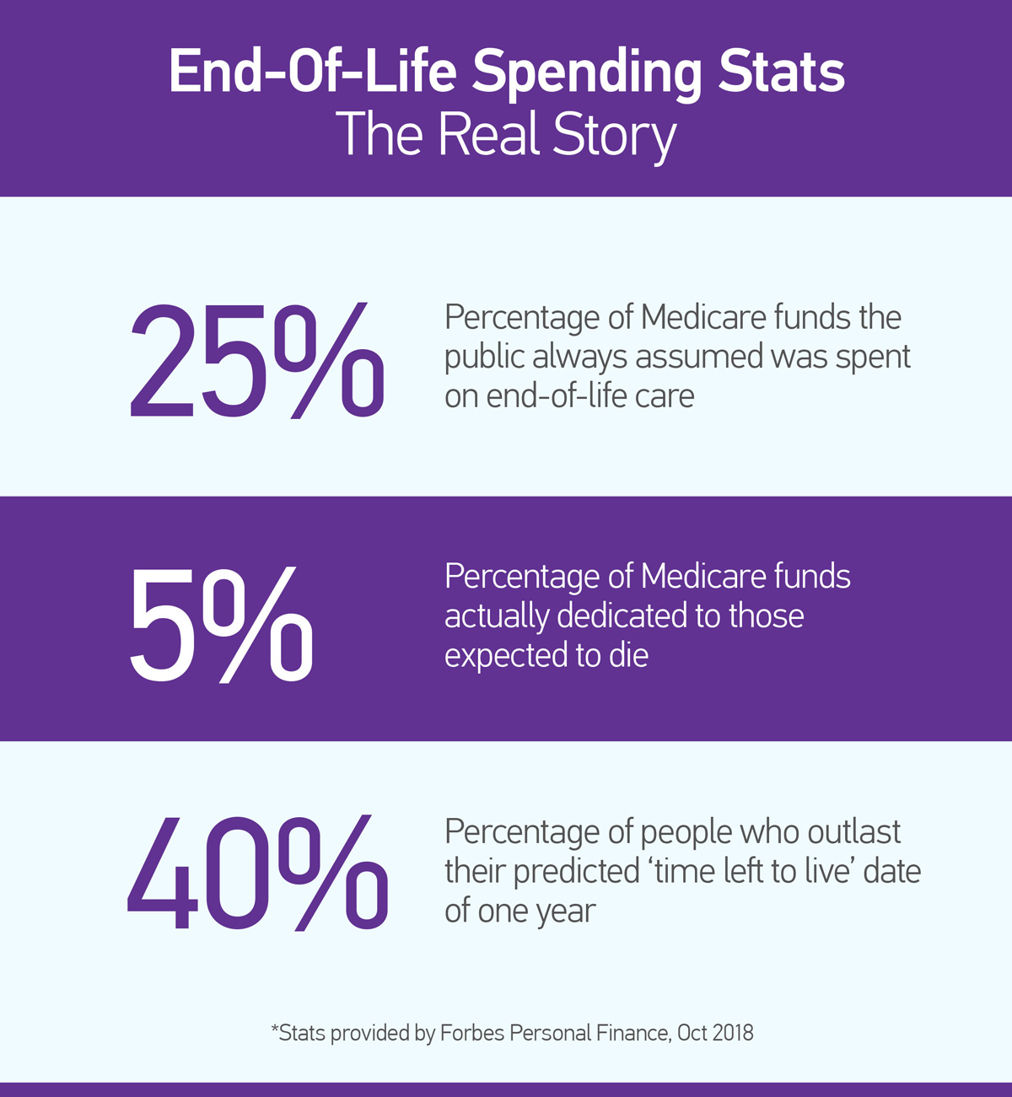
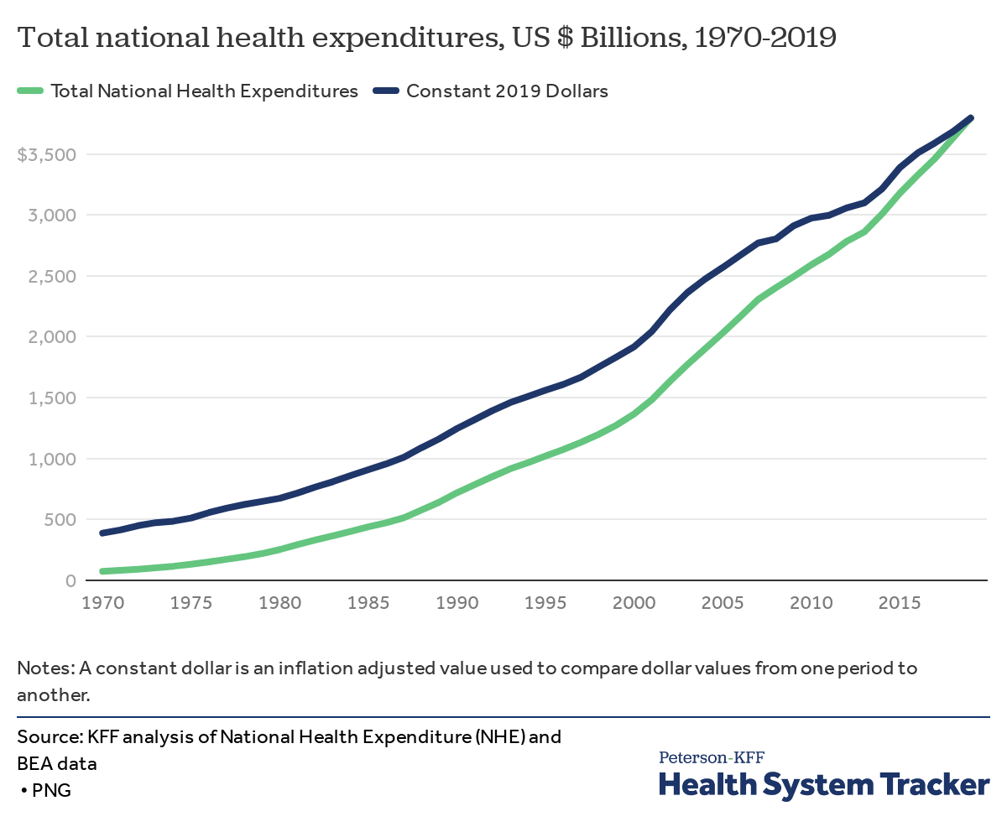
BACKGROUND
With the U.S. healthcare expenditure skyrocketing with an aging demographic, it is critical that health care delivery systems provide quality care that is cost-effective
This project looks at geographic variations in healthcare resources, utilization, and costs over time during the last six month of life
The results yield insights into future health policies to better meet social and medical needs of chronically and terminally ill patients while controlling costs.

Slide 3
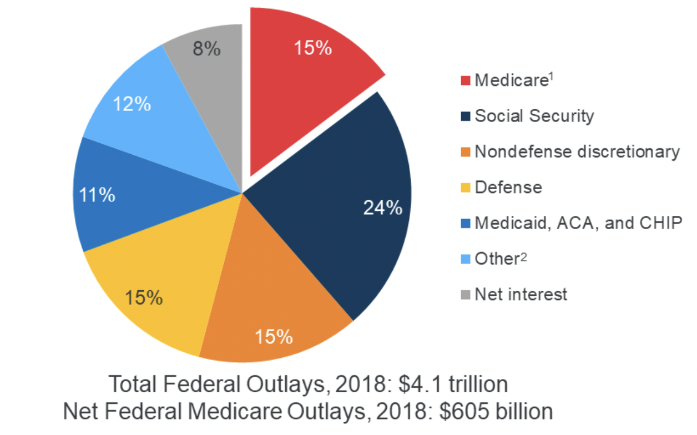
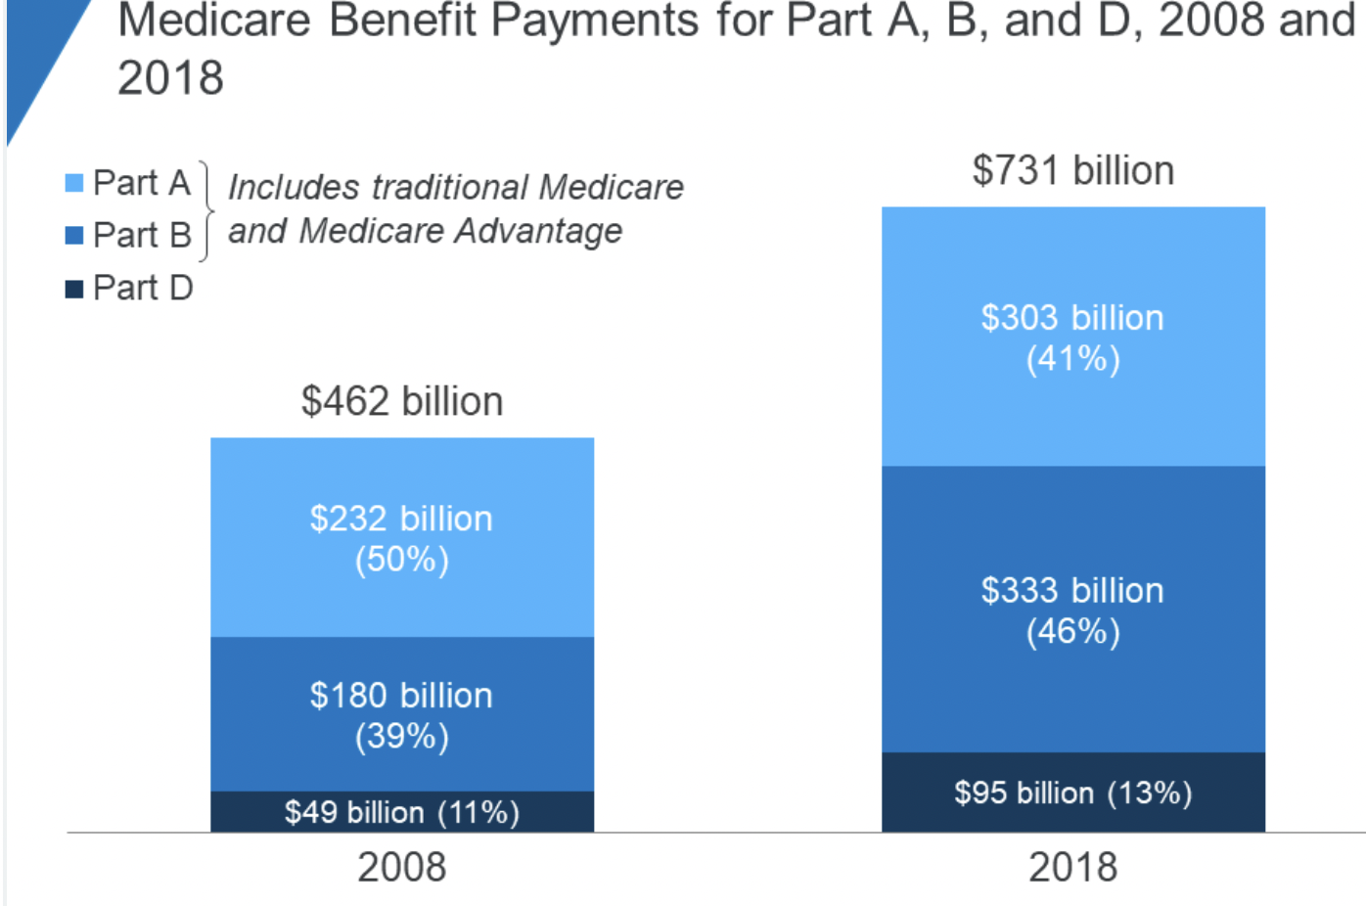
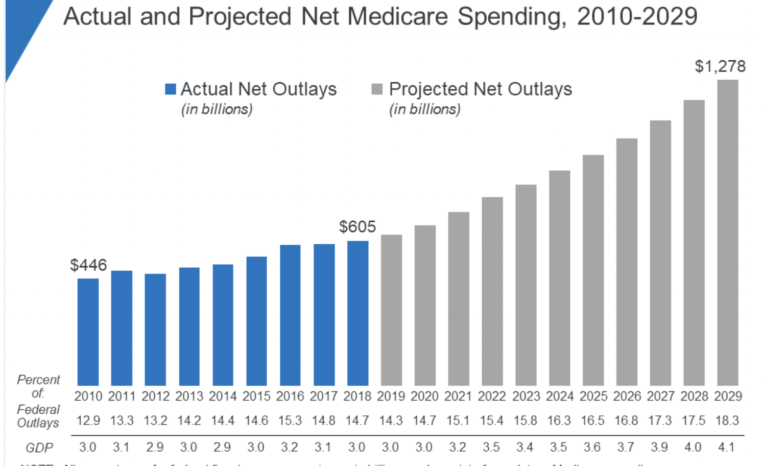
PROBLEM STATEMENT
In 2018, Medicare spending (net of income from premiums and other offsetting receipts) totaled $605 billion, accounting for 15 percent of the federal budget
In 2018, Medicare benefit payments totaled $731 billion, up from $462 billion in 2008
Notes:
PARI-Medicare spending varies more than two fold among hospital referral regions. Spending also varies from state to state, and from one hospital to another, even among hospitals within the same region. Most of this variation is not due to differences in the price of care in different parts of the country, but rather to differences in the volume, or the amount of inpatient care delivered per patient.
This project looks at geographic variations in healthcare resources, utilization, and costs over time during the last six month of life
While benefit payments for each part of Medicare (A, B, and D) increased in dollar terms over these years, the share of total benefit payments represented by each part changed. Spending on Part A benefits (mainly hospital inpatient services) decreased from 50 percent to 41 percent, spending on Part B benefits (mainly physician services and hospital outpatient services) increased from 39 percent to 46 percent, and spending on Part D prescription drug benefits increased from 11 percent to 13 percent.

Slide 4

PROBLEM STATEMENT CONTINUED
The Need: The U.S. healthcare expenditure is currently increasing on an unsustainable trajectory. With an aging demographic, it is more important than ever that health care delivery systems provide quality care that is cost-effective.
Across Geography: This project looks at geographic variations in healthcare resources, utilization, and costs over time during the last six month of life.
Technology: With implementation of electronic health record systems that made healthcare data available, researchers can yield great insights and make more coordinated care and services and precise health care delivery feasible for patients.
We want to find insights from the data to guide future health policies, clinical interventions, etc., for decision-makers at health care systems to better meet requirements of chronically and terminally ill patients while controlling costs

Slide 5

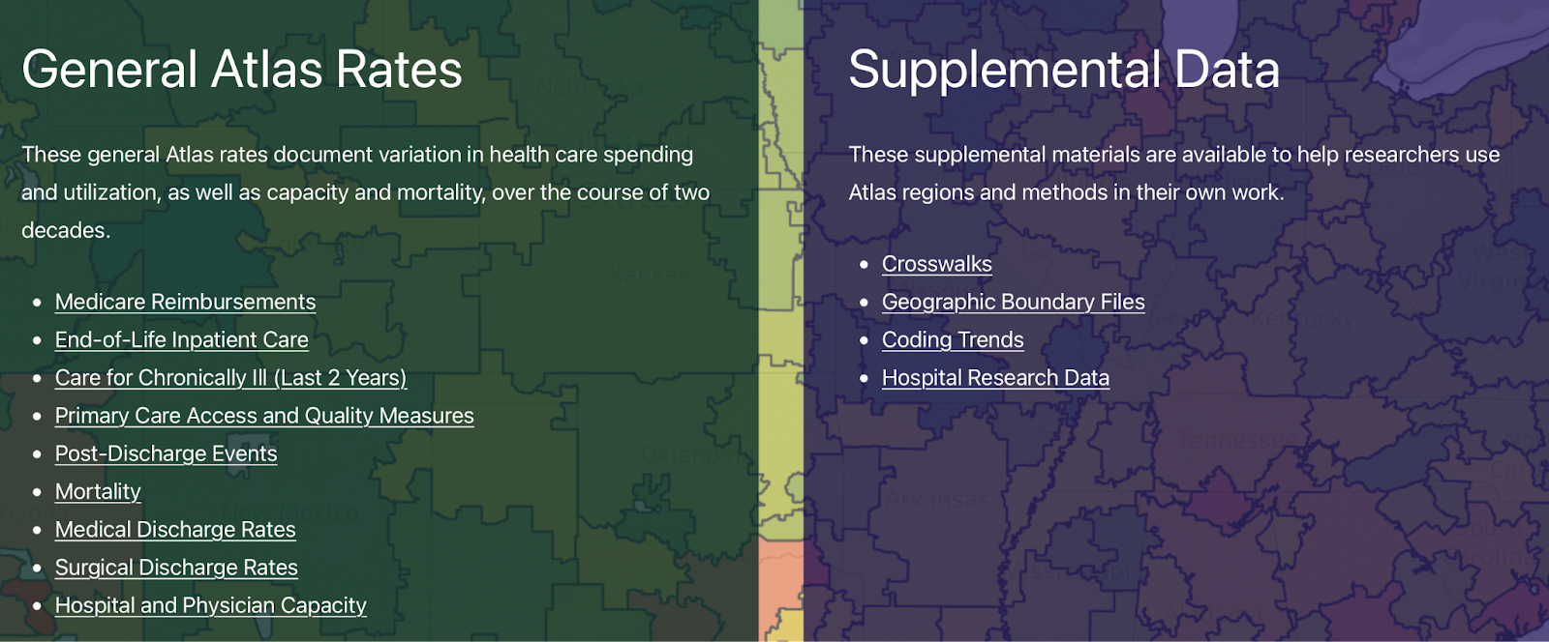
THE DARTMOUTH ATLAS OF HEALTHCARE
What is Dartmouth Atlas?
The Dartmouth Institute for Health Policy and Clinical Practice created a publicly available source of data providing metrics quantifying the temporal and regional patterns of health care spending and utilization.
For more that 20 years the Dartmouth Atlas Project has documented significant differences in how medical resources are distributed and used across the United States. The initiative makes use of Medicare and Medicaid data to provide statistics and analysis on national, regional, and local markets, as well as hospitals and linked physicians.

Slide 6
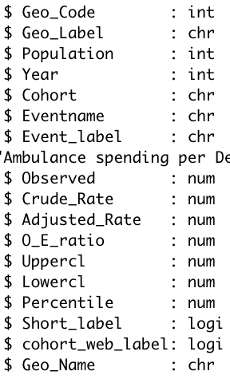
DATA EXPLORATION
The dataset that we choose was “State Data 2008-2019 End of Life Chronically Ill Patients - State Data 2008-2019 End of Life Chronically Ill Patients”
Structure of our dataset
Notes:
Dartmouth Atlas Medicare reimbursement rates are calculated from Medicare claims files from CMS. Fee-for-service patients enrolled in Medicare Parts A and B are included.

Slide 7
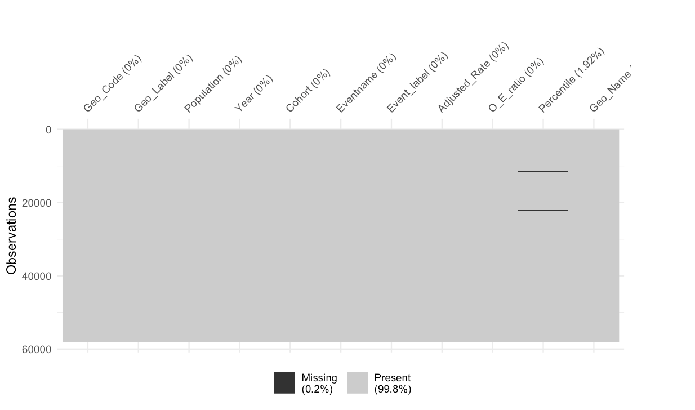
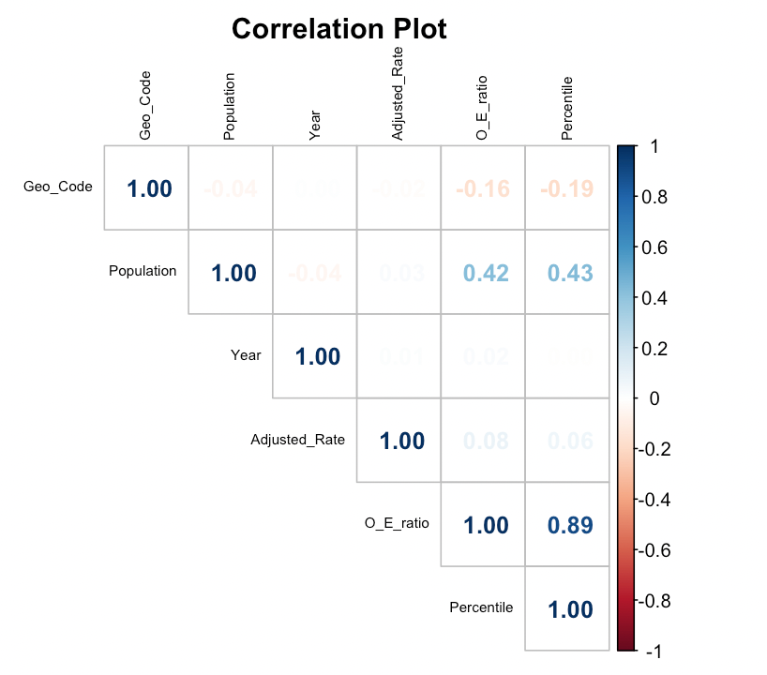
Checking for total missingness in our dataset
Correlation between the variables

Slide 8
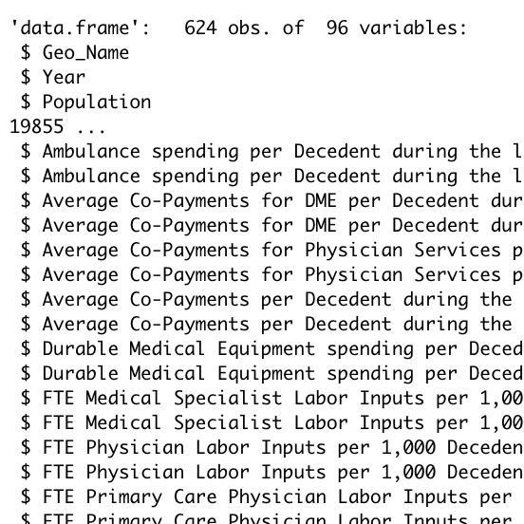
After looking into the spending and reimbursement data we did some wrangling and now we have a new structure for a data set to work with.
Notes:
Part B covers certain doctor's services, outpatient care, medical supplies, and preventive services.

Slide 9


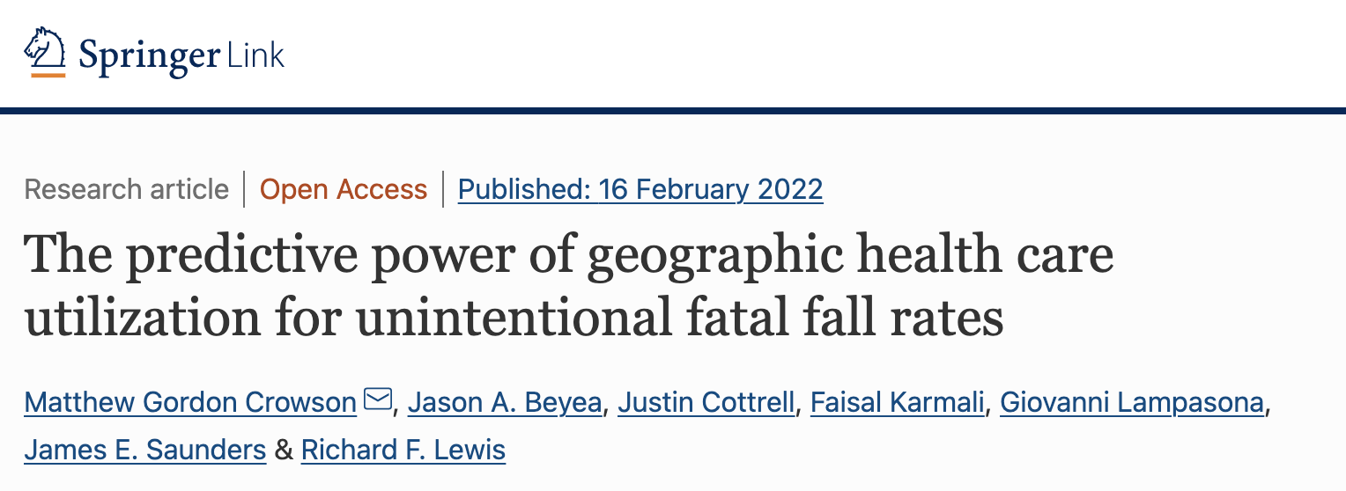


STATE OF THE ART
There are currently many publicly available data sources, including the Dartmouth Atlas, that researchers and the general public have utilized to generate reports consisting of interactive geographical maps of healthcare data.
Many Accountable Care Organizations (ACOs) have also used predictive modeling and risk stratification to sort their entire population into different risk levels to better match patients to appropriate interventions that allows health care systems to provide higher-quality care and allocate limited resources more effectively.

Slide 10
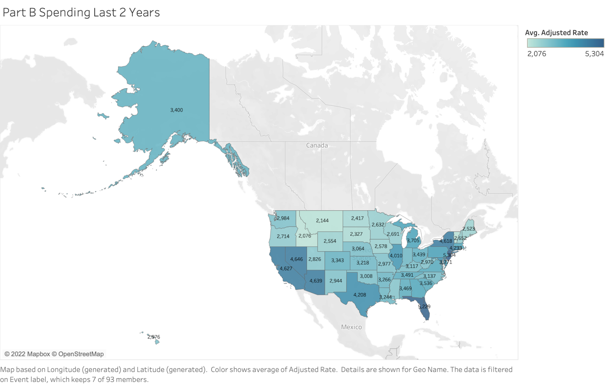
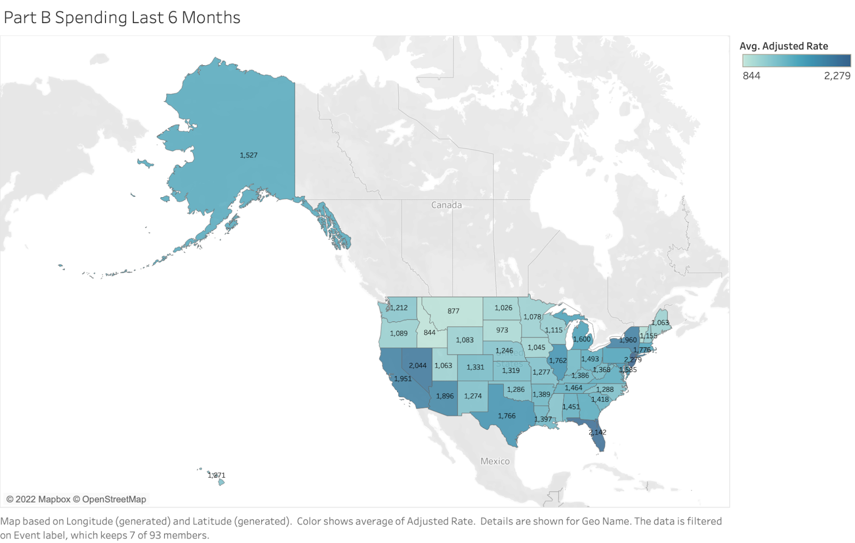
VISUALIZING THE DATA
Average Spending in Last 2 Years of life and Last 6 Months by State

Slide 11
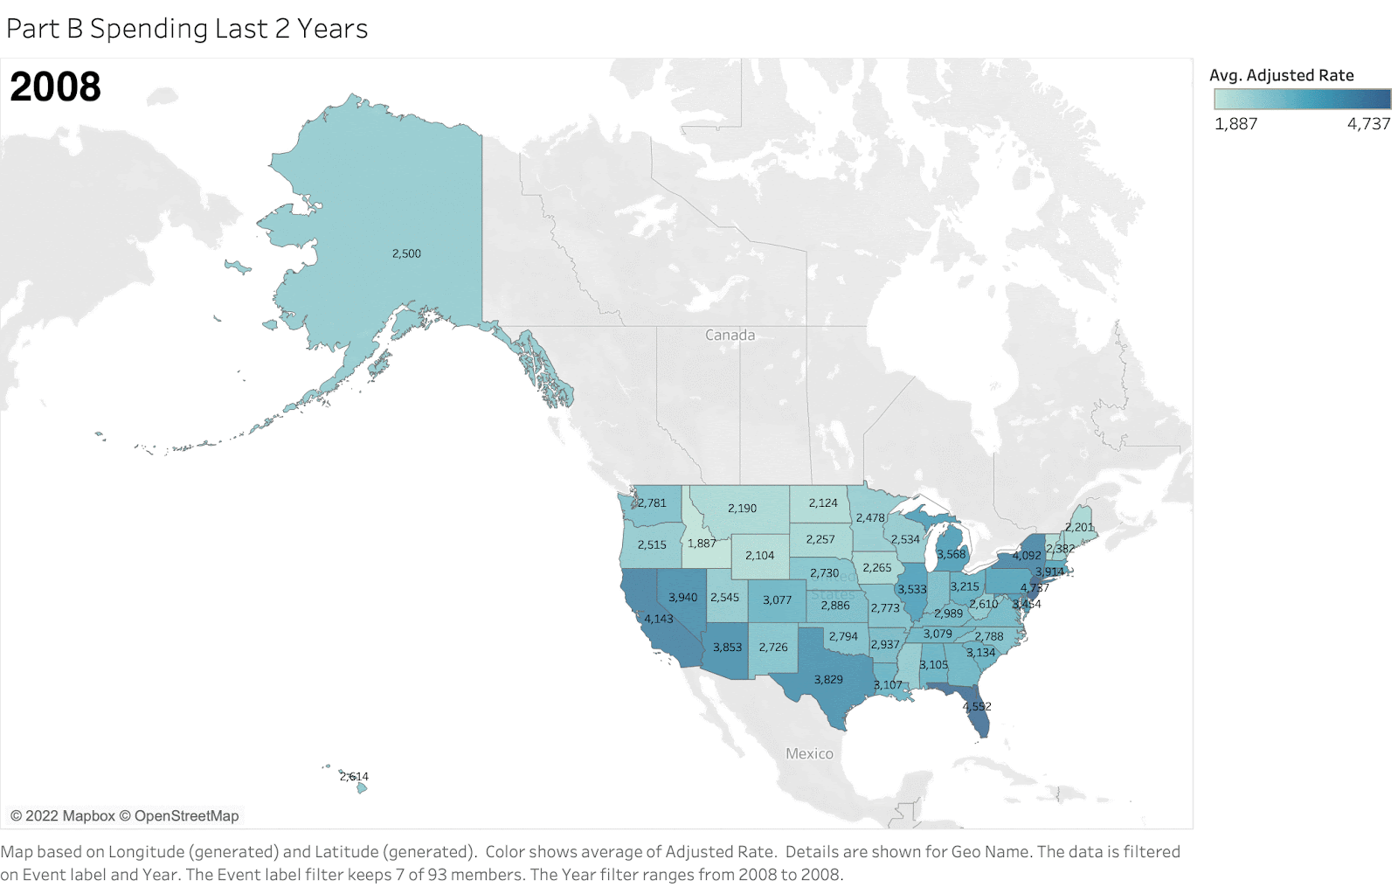
OVER THE YEARS…
It doesn’t seem to change much :) (nothing drastic sticks out)
This is spending in the last 2 years of a patient’s life

Slide 12
OVER THE YEARS… SLOWER
Same GIF as before but slower

Slide 13
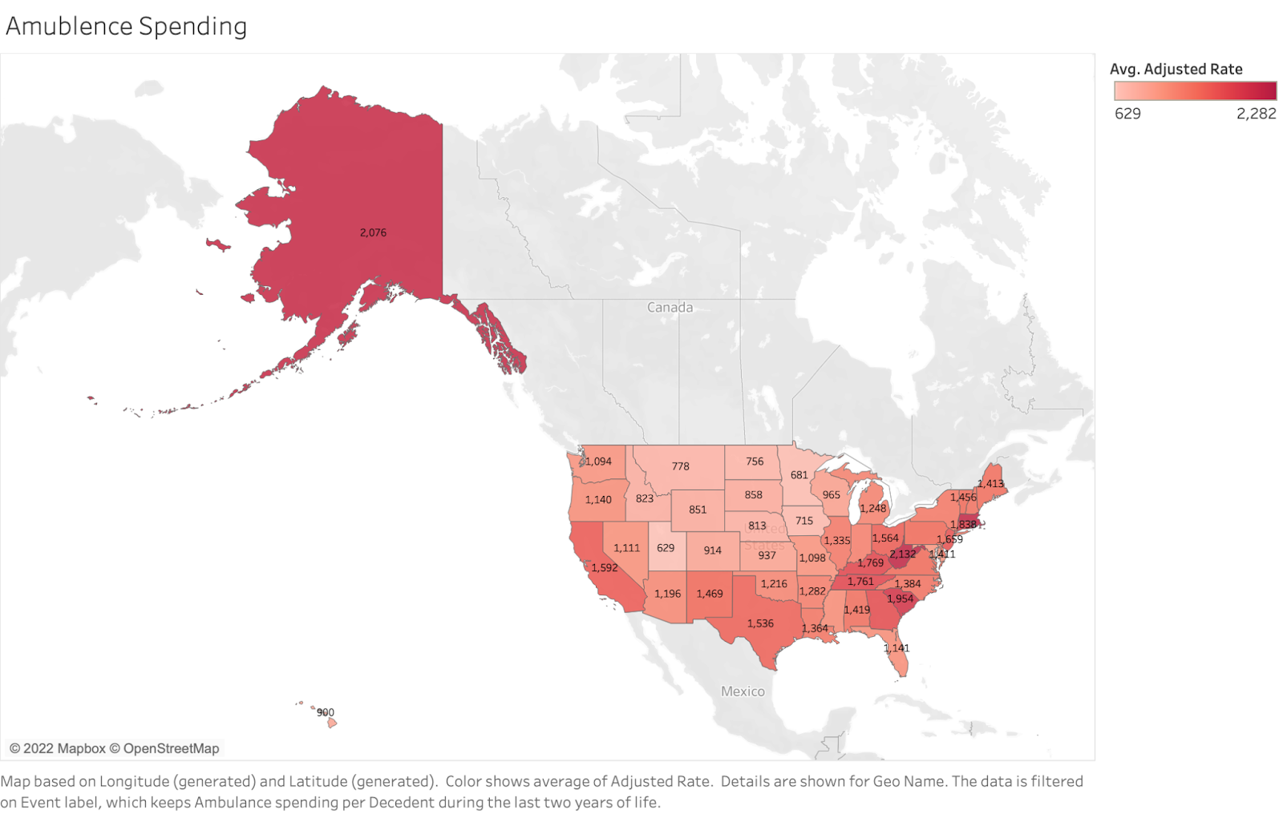
AMBULANCE SPENDING
Average ambulance spending (across all years from 2008-2019)

Slide 14
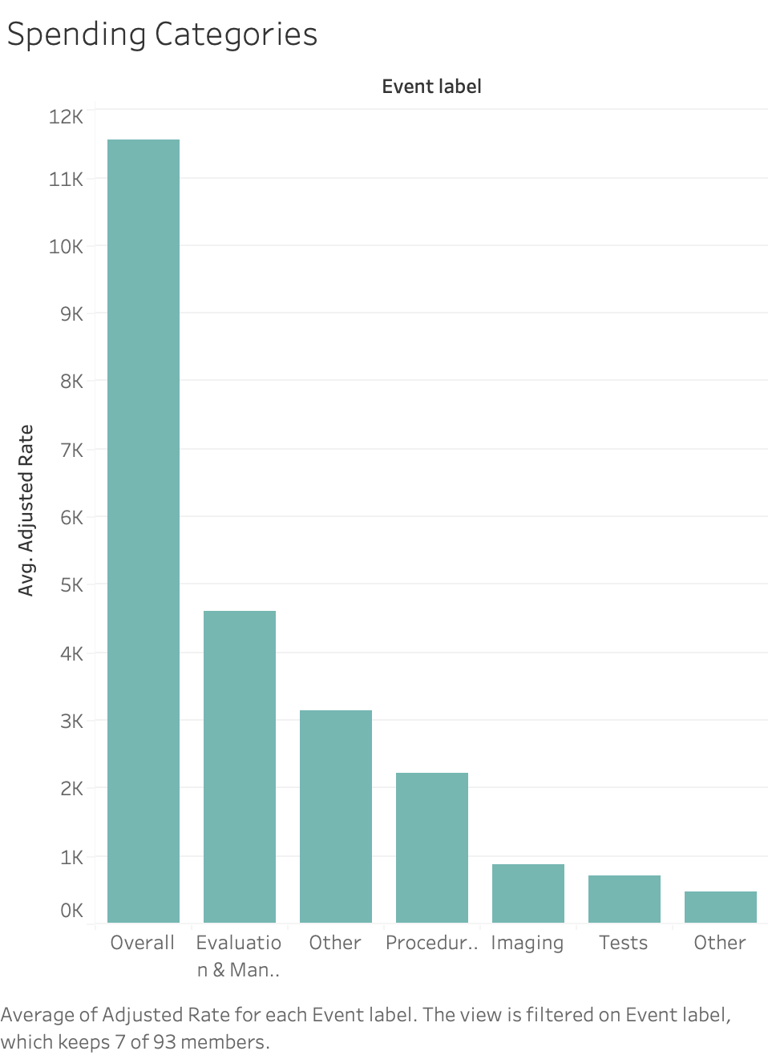
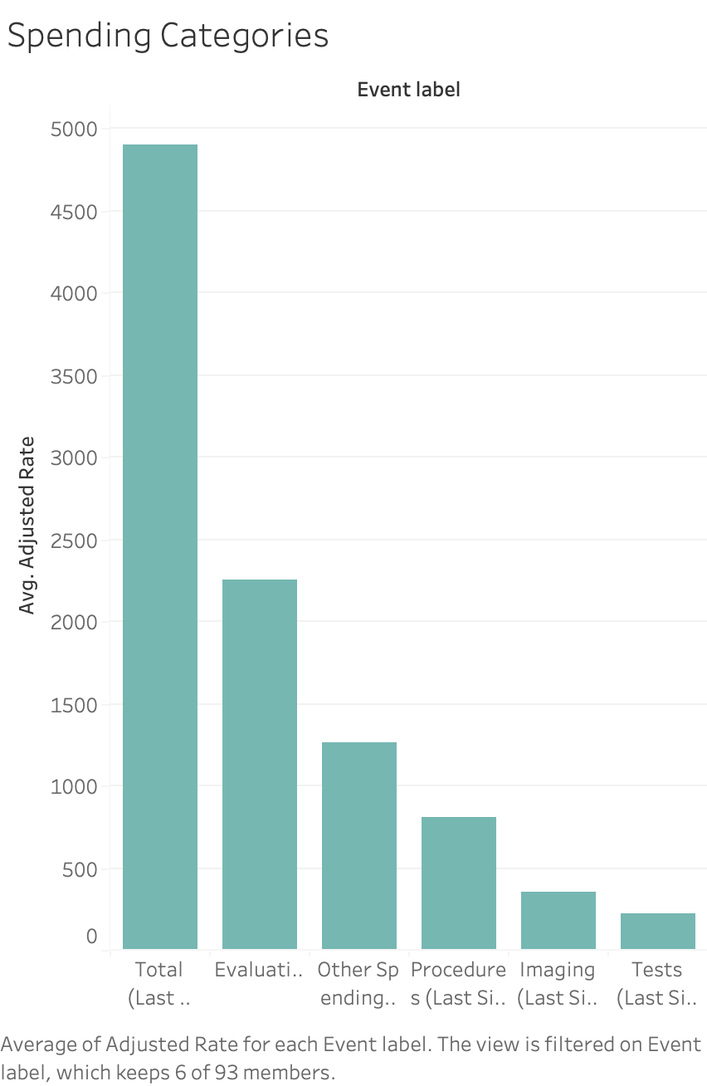
SPENDING CATEGORIES
Last 2 years of life
Last 6 months of life
Average spending by different categories across all states

Slide 15
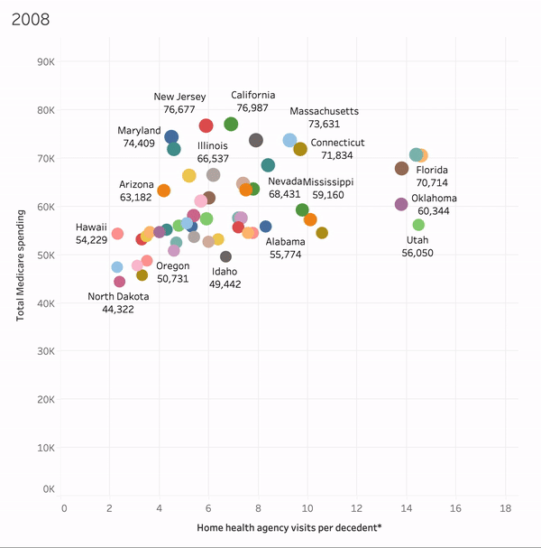
HOME HEALTH VISITS TO MEDICARE SPENDING

Slide 16
REGRESSION
Model: Linear Mixed Model
Outcome: Part B Spending per Decedent during the Last Six Months of Life
Covariates:
ICU Days per Decedent During the Hospitalization In Which Death Occurred
Physician Visits per Decedent during the Last Six Months of Life
Number of Different Physicians Seen per Decedent during the Last Six Months of Life
High-Intensity ICU Bed Inputs per 1,000 Decedents during the Last Six Months of Life
Home Health Agency Visits per Decedent during the Last Six Months of Life
Percent of Decedents Enrolled In Hospice during the Last Six Months of Life
State
Random Effects: Years

Slide 17
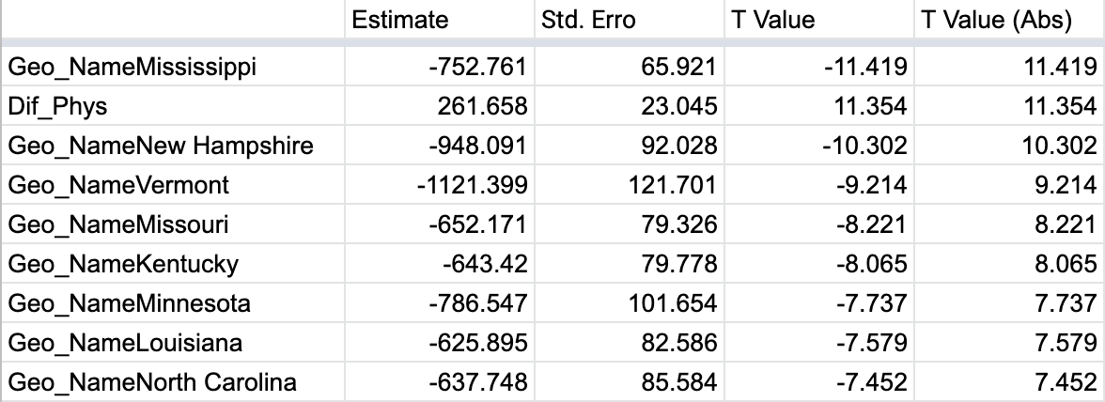
REGRESSION RESULTS

Slide 18
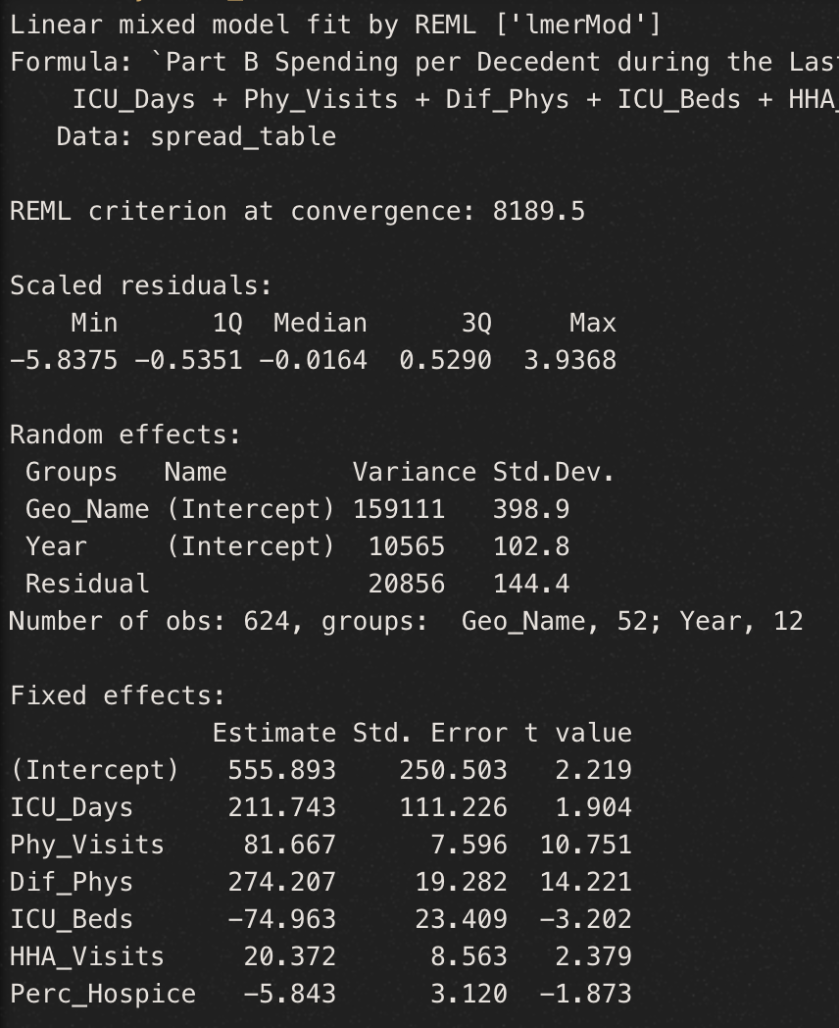
IN RUNNING 3 DIFFERENT REGRESSION MODELS…
The Number of Different Physicians Stays Highly Significant!
The model on the left clusters the information by state instead of having state as a covariate

Slide 19
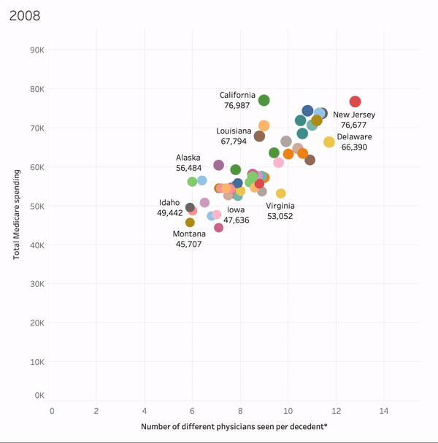
LOOKING CLOSER AT DIFFERENT PHYSICIANS

Slide 20
CONCLUSION
Positive associations between healthcare utilization characteristics such as hospital days, ICU days, physician visits, and healthcare spending have been discovered after analyzing the End-of-Life Care data.
The data also revealed a regional pattern in healthcare consumption and cost: Midwestern states have fewer total Medicare spending and shorter hospital stays. Given their greater intensity healthcare use, states on the West Coast have higher than average total spending per patient, whereas southern and midwestern states have lower healthcare intensity and lower total spending on average. New England states in the northeast have higher healthcare spending intensity and total spending.
Our time-series data also revealed changes in healthcare utilization and expense over time: while hospital stays have decreased from 2008 to 2019, end-of-life care spending has remained high.

Slide 21
THANK YOU

